Slide 1
Poshable | Accessories
New edition

Slide 2
Poshable | Accessories
Poshable | Accessories, according to the looks of ‘Project Cube’, is a small, potential, unique and growing business, has room for improvement with the right items, products and time.

Slide 3
Poshable | Accessories products
Products that are not being sold more are therefore the one’s that have room for improvement left in them. For example: ‘Bookmark’, this physical product can be useful for books where owner gets to stop or pause where they last left off with their book. Poshable sells bookmarks but it does not sell much, therefore an idea behind this could be having Poshable to also sell books that go along with bookmarks, resulting to R = PP + EP (Revenue = Potential Product + Extra Product)

Slide 4
Popularity designs and images
Poshable | Accessories designs mugs, tumblers, cups and bookmarks. Do people like the designs? Feedback shall be the answer, yes, but what if they were cartoon or popular. For example, instead of pasting whichever design on the tumbler, some designs or images pasted be any old popular cartoon such as ‘Adventure Time, Regular Show, Amazing World of Gumball, etc’, this shall surely be nostalgic for some people, it could be series also such as ‘Stranger Things’ considering how many people miss the cast.

Slide 5
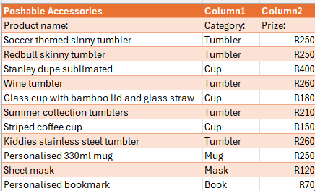
Excel spreadsheet 1

Slide 6
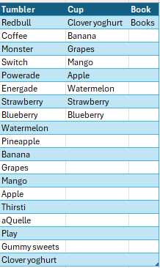
Excel spreadsheet 2

Slide 7
Excel spreadsheet 1:
-displaying all of the products that Poshable | Accessories keeps and sells
-category that they are under and prizes
-will be useful in the future for a graphical display as to which product is resulting to a drought for the business and costing you more then having to sell it

Slide 8
Excel spreadsheet 2:
-binding potential products with extra products (R = PP + EP)
-this shall result to more revenue made and ‘Best Selling Product’ within the business
-do not restock every month, restock when customer wants it
-prizing shall be determined by the business owner
-segregates you from the rest of the businesses, resulting to uniqueness and creativity

Slide 9
NOTE
-this can be useful for sport events or parties but discussed with the host of the event
-reason with the prizing for the extra products
-R = PP + EP only works if products goes along with it
-if product does not make much revenue then therefore it should be paused until the best time or solution comes up

Slide 10
Change, Stabalize & Improve
CHANGE | STABALIZE | IMRPOVE
Restocking non-winning products | Winning product/s | Collaboration
Price change or decrease |  | Ice-coffee
 |  | Matcha
 |  | Liquid mixture: *redbull & mocktail *redbull & sweets & other liquid *sweets and liquid *juice / energy drinks with other ingredients

